Slide 1
Designing Class
1

Slide 2
Designing a Class
Coherence:
A class should describe a single entity, and all the class operations should logically fit together to support a coherent purpose.
You can use a class for students, for example, but you should not combine students and staff in the same class, because students and staff have different entities.
20

Slide 3
Designing a Class, cont.
Separating responsibilities:
A single entity with too many responsibilities can be broken into several classes to separate responsibilities.
The classes String, StringBuilder, and StringBuffer all deal with strings, for example, but have different responsibilities.
The String class deals with immutable strings, the StringBuilder class is for creating mutable strings, and the StringBuffer class is similar to StringBuilder except that StringBuffer contains synchronized methods for updating strings.
21

Slide 4
Designing a Class, cont.
Naming, Placing & Initializing:
Follow standard Java programming style and naming conventions. Choose informative names for classes, data fields, and methods.
Always place the data declaration before the constructor, and place constructors before methods.
Always provide a constructor and initialize variables to avoid programming errors.
24

Slide 5
Using Visibility Modifiers
Private, Public & Protected:
Each class can present two contracts – one for the users of the class and one for the extenders of the class.
Make the fields private and accessor methods public if they are intended for the users of the class.
Make the fields or method protected if they are intended for extenders of the class.
-P.T.O
25

Slide 6
Using Visibility Modifiers
A class should use the private modifier to hide its data from direct access by clients.
You can use get methods and set methods to provide users with access to the private data, but only to private data you want the user to see or to modify.
A class should also hide methods not intended for client use.
26

Slide 7
Visibility (Access) Modifiers
public: The class, data, or method is visible to any class in any package.
private: The data or methods can be accessed only by the declaring class.
default: the class, variable, or method can be accessed by any class in the same package.

Slide 8
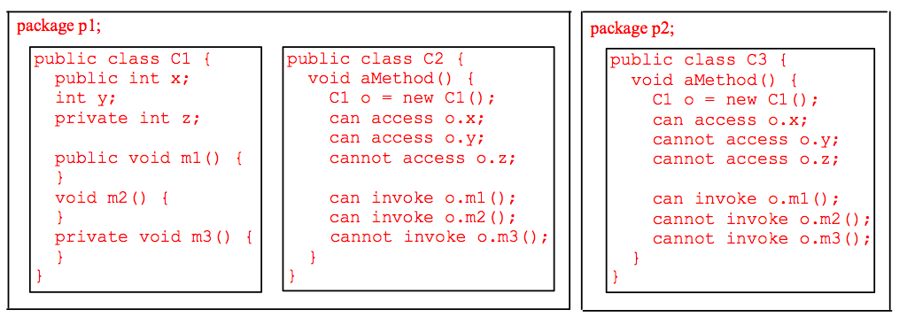
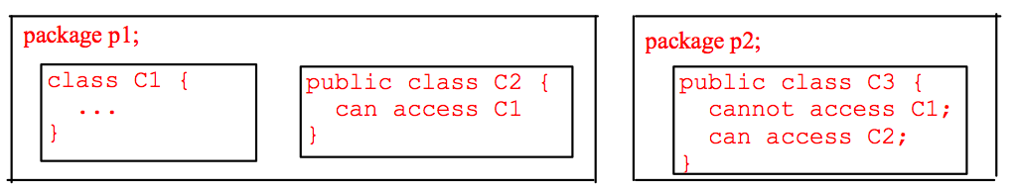
The private modifier restricts access to within a class, the default modifier restricts access to within a package, and the public modifier enables unrestricted access.

Slide 9
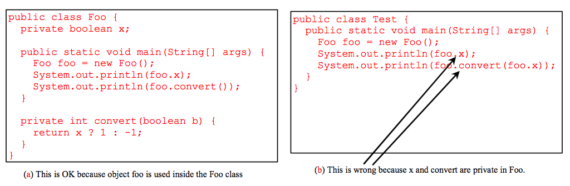
NOTE
An object cannot access its private members, as shown in (b). It is OK, however, if the object is declared in its own class, as shown in (a).

Slide 10
Array of Objects
Circle[] circleArray = new Circle[10];
An array of objects is actually an array of reference variables.
So invoking circleArray[1].getArea() involves two levels of referencing
circleArray references to the entire array.
circleArray[1] references to a Circle object.

Slide 11
Trace Code
animation
Declare myCircle
Circle myCircle = new Circle(5.0);
Circle yourCircle = new Circle();
yourCircle.radius = 100;
myCircle
no value

Slide 12
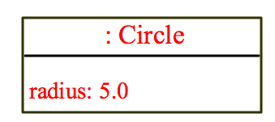
Trace Code, cont.
animation
Circle myCircle = new Circle(5.0);
Circle yourCircle = new Circle();
yourCircle.radius = 100;
myCircle
no value
Create a circle

Slide 13
Trace Code, cont.
animation
Circle myCircle = new Circle(5.0);
Circle yourCircle = new Circle();
yourCircle.radius = 100;
myCircle
reference value
Assign object reference to myCircle

Slide 14
Trace Code, cont.
animation
Circle myCircle = new Circle(5.0);
Circle yourCircle = new Circle();
yourCircle.radius = 100;
myCircle
reference value
yourCircle
no value
Declare yourCircle

Slide 15

Trace Code, cont.
animation
Circle myCircle = new Circle(5.0);
Circle yourCircle = new Circle();
yourCircle.radius = 100;
myCircle
reference value
yourCircle
no value
Create a new Circle object

Slide 16
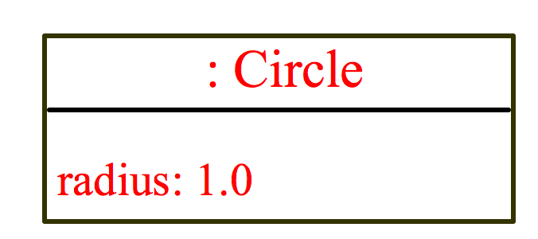
Trace Code, cont.
animation
Circle myCircle = new Circle(5.0);
Circle yourCircle = new Circle();
yourCircle.radius = 100;
myCircle
reference value
yourCircle
reference value
Assign object reference to yourCircle

Slide 17
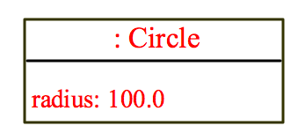
Trace Code, cont.
animation
Circle myCircle = new Circle(5.0);
Circle yourCircle = new Circle();
yourCircle.radius = 100;
myCircle
reference value
yourCircle
reference value
Change radius in yourCircle

Slide 18
The this Keyword
The this keyword is the name of a reference that refers to an object itself. One common use of the this keyword is reference a class’s hidden data fields.
Another common use of the this keyword to enable a constructor to invoke another constructor of the same class.
8

Slide 19
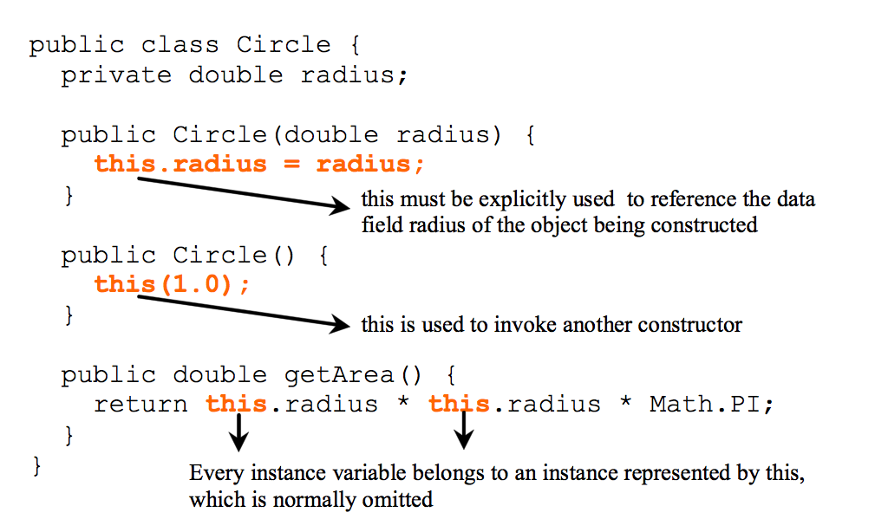
Calling Overloaded Constructor
10

Slide 20
Using the static Modifier
A property that is shared by all the instances of the class should be declared as a static property.
27

Slide 21
Static vs Instance
Instance variables belong to a specific instance.
Instance methods are invoked by an instance of the class.
Constants are final variables that can’t be changed once defined.
Static variables are shared by all the instances of the class. Static methods are not tied to a specific object.
Static constants are final variables shared by all the instances of the class.

Slide 22
Static constants are final variables shared by all the instances of the class.

Slide 23
Static Variables, Constants, and Methods, cont.
To declare static variables, constants, and methods, use the static modifier.

Slide 24
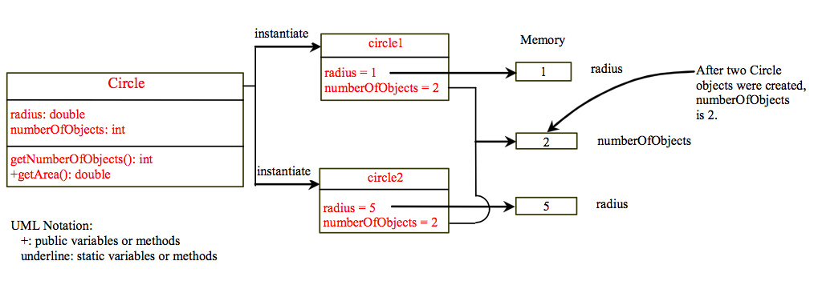
Static Variables, Constants, and Methods, cont.

Slide 25
Reference Data Fields
The data fields can be of reference types.
For example, the following Student class contains a data field name of the String type.
public class Student {
String name; // name has default value null
int age; // age has default value 0
boolean isScienceMajor; // isScienceMajor has default value false
char gender; // c has default value '\u0000'
}

Slide 26
The null Value
If a data field of a reference type does not reference any object, the data field holds a special literal value, null.

Slide 27
Default Value for a Data Field
The default value of a data field is null for a reference type, 0 for a numeric type, false for a boolean type, and '\u0000' for a char type. However, Java assigns no default value to a local variable inside a method.
public class Test {
public static void main(String[] args) {
Student student = new Student();
System.out.println("name? " + student.name);
System.out.println("age? " + student.age);
System.out.println("isScienceMajor? " + student.isScienceMajor);
System.out.println("gender? " + student.gender);
}
}

Slide 28
Example
Java assigns no default value to a local variable inside a method.
public class Test {
public static void main(String[] args) {
int x; // x has no default value
String y; // y has no default value
System.out.println("x is " + x);
System.out.println("y is " + y);
}
}
Compilation error: variables not initialized

Slide 29
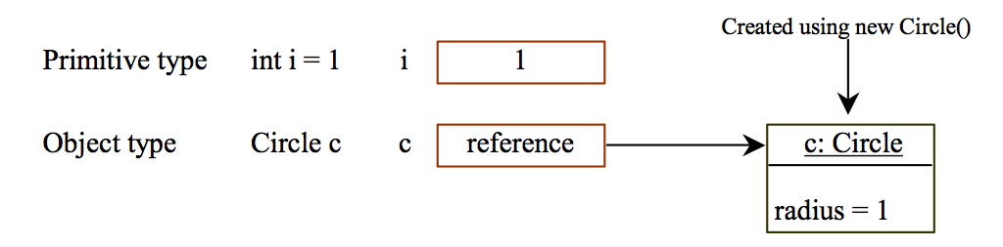
Differences between Variables of Primitive Data Types and Object Types

Slide 30
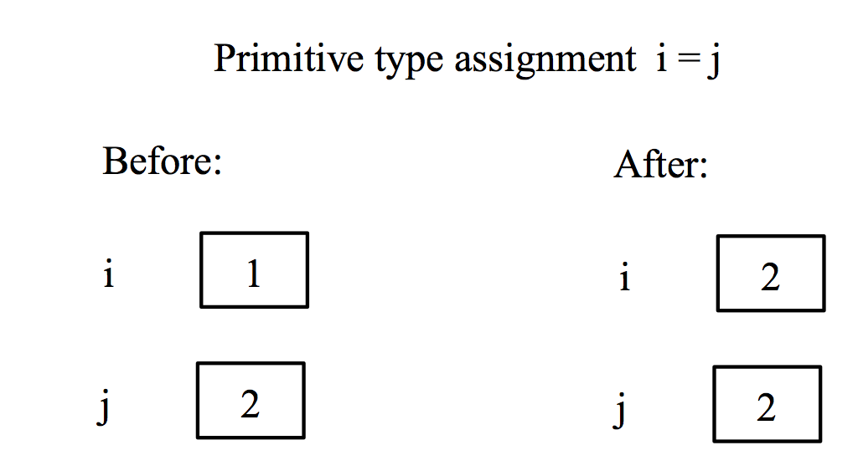
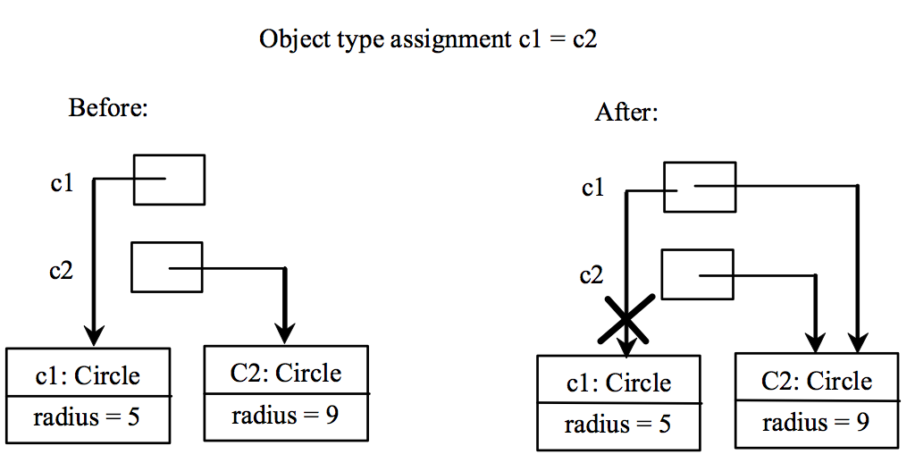
Copying Variables of Primitive Data Types and Object Types

